Slide 1
40445365_Web_Reference
CSc1034 Coursework – Group 027

Slide 2
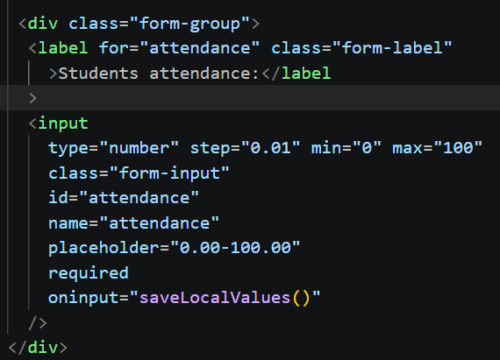
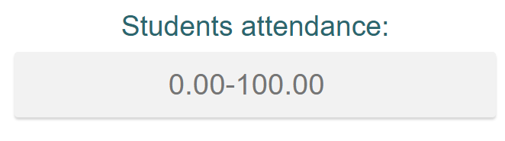
Crud – Attendance - Create
For this PPt I will be using Attendance which I made and validated for this project as an example of the code
This code is used to create a textbox to input the attendance value for the student form

Slide 3
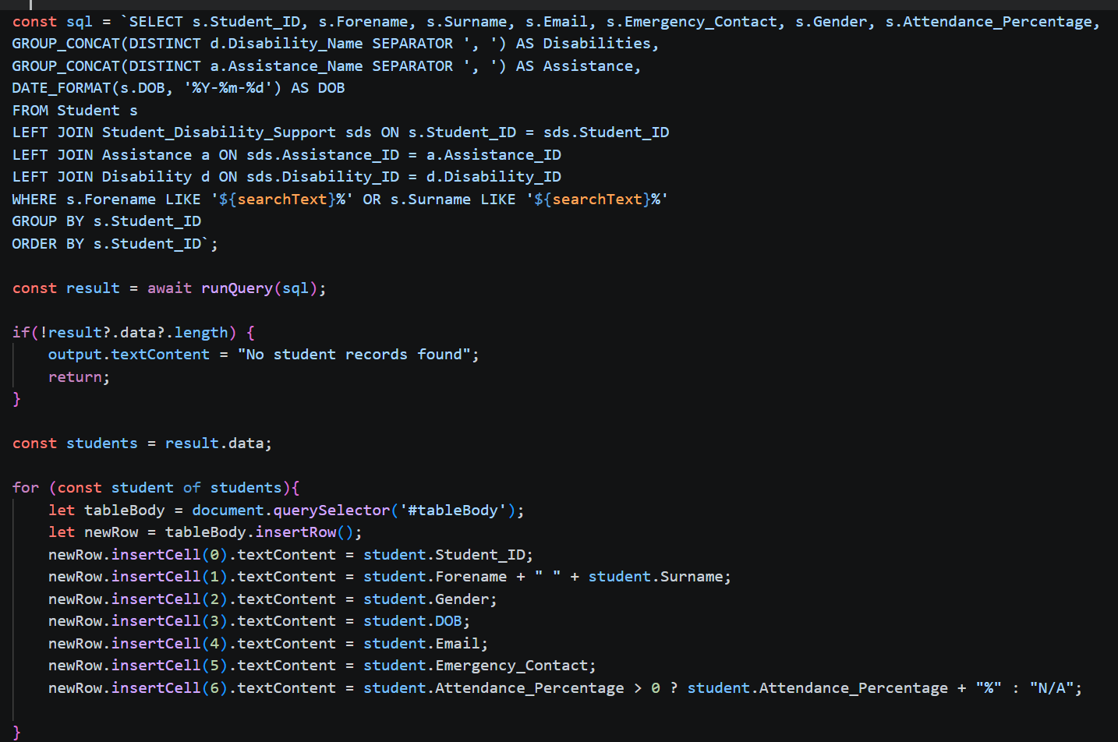
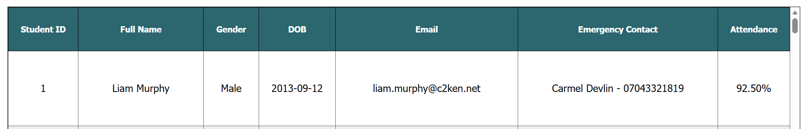
Crud – Attendance - read
This code is used to display the attendance to the Students Record table in readRecords.html
(I wasn’t the sole creator of this code however did assist in its creation and I did create aspects of it including the Attendance part which I am covering)

Slide 4
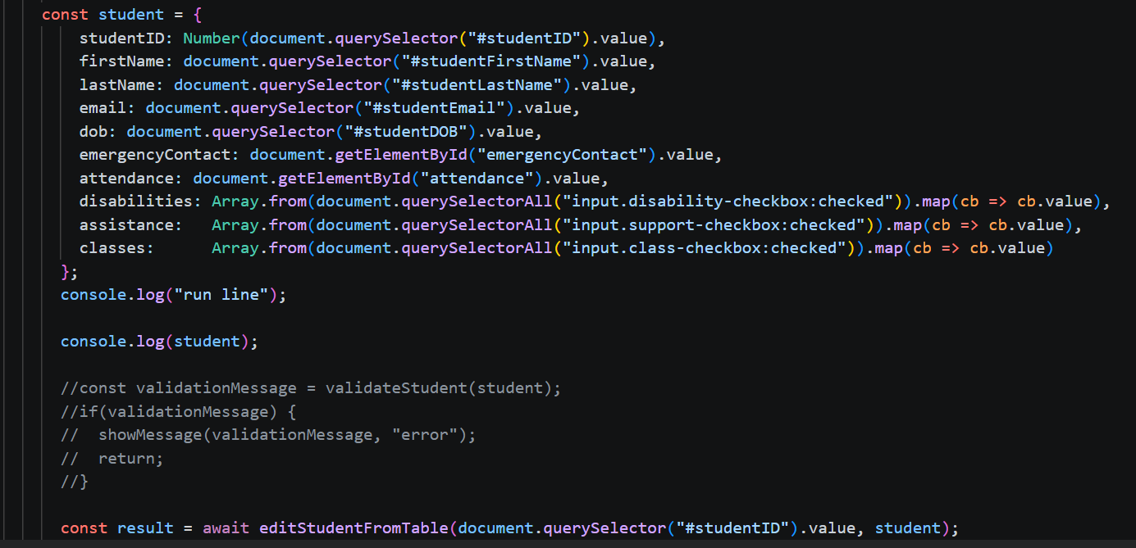
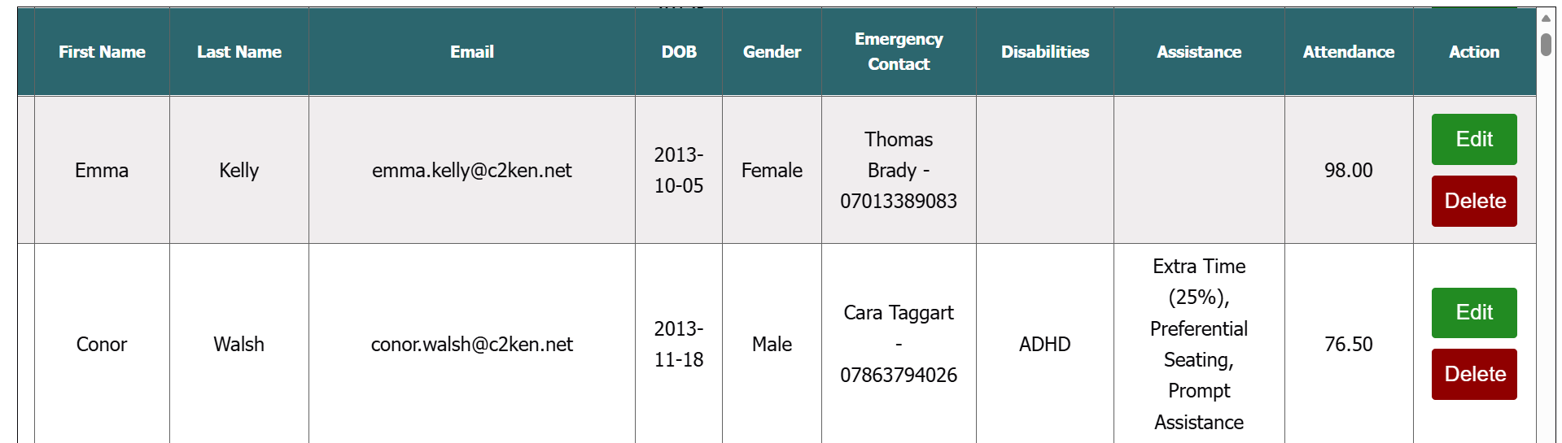
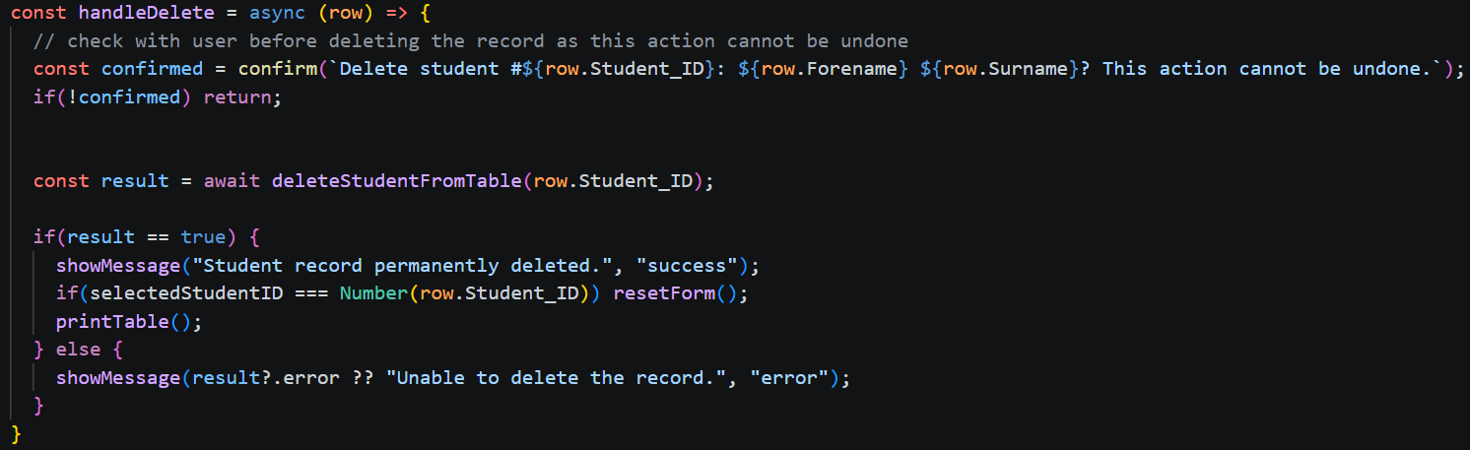
Crud – Attendance – Update and delete
This code is used to set the new values to the records in changeRecords.html
(I wasn’t the sole creator of this code however did assist in its creation and I did create aspects of it including the Attendance part which I am covering)
This code is used to delete the selected record in changeRecords.html, this code is also reused later to assist in removing any no longer valid records through the delete button
(I wasn’t the sole creator of this code however did assist in its creation)

Slide 5
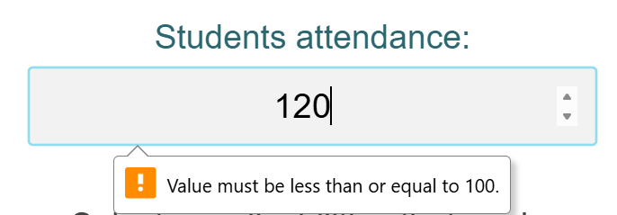
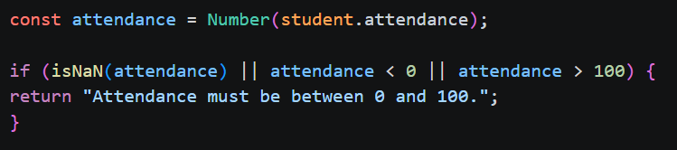
Validation – Attendance
Ensures that the data entered cannot be out of the appropriate range e.g. 0-100

Slide 6
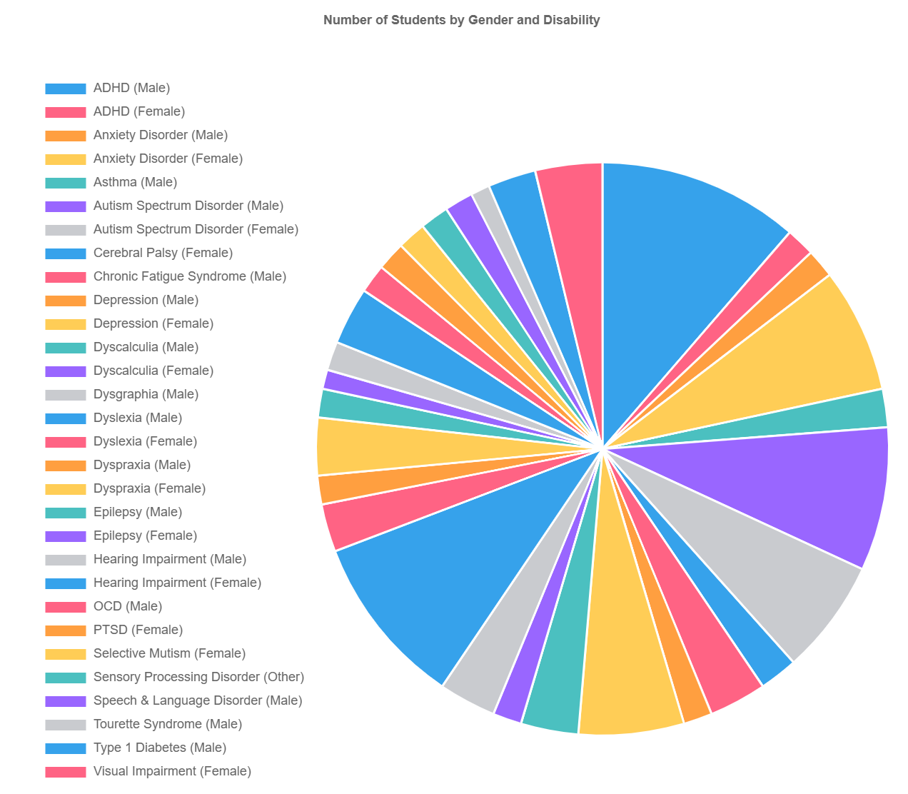
One of my 3 reports
This is one of my 3 reports. This Specific report shows the variety of different disabilities separated by gender within the database
The data is pulled live from the database and is then formatted into an interactive pie chart that displays details when hovering over a specific section (Sections can also be removed for user convenience)

